Slide 1
Status of Datalink Implementation in the Asia Pacific Region
Toby Farmer, CAA New Zealand

Slide 2
First Steps
1995 Worlds first operational use of CPDLC and ADS-C using datalink
ACARS
ANSP Airways New Zealand
Operator Qantas

Slide 3
FANS-1/A
CPDLC/ADS-C over ACARS became known as FANS-1
FANS-1 based on Boeing implementation
Airbus implementation slightly different
FANS-1 adapted to cater for both
Hence FANS-1/A

Slide 4
South Pacific
CPDLC/ADS-C using FANS-1/A spread
Now operational in:
Auckland Oceanic FIR
Brisbane FIR
Nadi FIR
Tahiti FIR
Oakland FIR

Slide 5
Rest of Asia Pacific
Operational CPDLC/ADS-C systems:
Melbourne FIR
Singapore
Japan (Fukuoka FIR)
Vietnam
India (Chennai FIR)

Slide 6
Rest of Asia Pacific
CPDLC/ADS-C systems being implemented in:
Chile
China (trials)
Maldives (testing)
India
Philippines

Slide 7
Rest of Asia Pacific
CPDLC/ADS-C systems being planned for:
Papua New Guinea
Thailand

Slide 8
Rest of Asia Pacific
Some FIRs may not need CPDLC/ADS-C:
FIRs with full VHF and surveillance coverage
FIRs where an external ANSP controls the upper airspace
(E.g. some Pacific Island States)

Slide 9
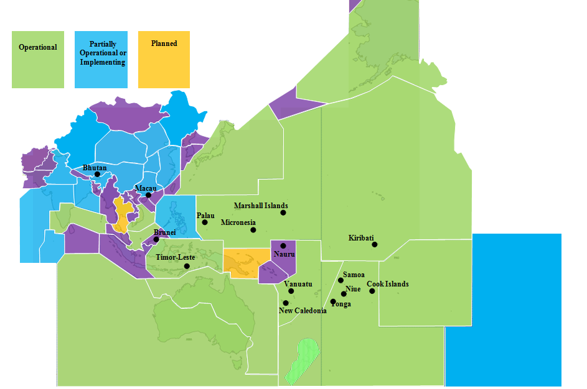
The Big Picture

Slide 10
AIDC
The less glamorous datalink!
Most important for ATC-ATC co-ordinatation
Carried over AFTN/AMHS

Slide 11
Datalink Performance Monitoring
To assure maintenance of RCP and RSP (PBCS) requirements
To provide basis for continuous performance improvement
To identify problems
Monitoring guidance in GOLD
(will move to PBCS Manual Doc 9869)

Slide 12
Datalink Performance Monitoring
Monitor:
CPDLC monthly
ADS-C monthly
AIDC six-monthly
And when there are changes to the system

Slide 13
Reference Material
Global Operational Data Link Document (GOLD)
Guidance Material for the Asia/Pacific Region for ADS/CPDLC/AIDC Ground Systems Procurement and Implementation
Guidance Material for End-to-End Safety And Performance Monitoring of Air Traffic Service (ATS) Data Link Systems in the Asia/Pacific Region

